Slide 1
Objectives
In this session, you will learn to:
Use functions to customize the result set

Slide 2
Using Mathematical Functions
Mathematical functions are used to manipulate the numeric values in a result set.
The following table lists some of the mathematical functions provided by SQL Server.
Function name | Parameters | Example | Description
ceiling | (numeric_expression) | SELECT ceiling(14.45) | Returns 15, the smallest integer greater than or equal to the specified value
exp | (float_expression) | SELECT exp(4.5) | Returns 90.0171313005218, the exponential value of the specified value
floor | (numeric_expression) | SELECT floor(14.45) | Returns14, the largest integer less than or equal to the specified value
power | (numeric_expression, y) | SELECT power(4,3) | Returns 64, which is 4 to the value of 3
round | (numeric_expression, length) | SELECT round(15.789, 2) | Returns 15.790, a numeric expression rounded off to the length specified as an integer expression
Notes:
Explain the purpose of using mathematical functions. Then, describe some of the math functions provided by SQL Server 2005. The slide lists only the frequently used math functions. You can also discuss other math functions given in SG.

Slide 3
Using Mathematical Functions (Contd.)
The following table lists the usage of the round() function provided by SQL Server.
Function | Output
round (1234.567,2) | 1234.570
round (1234.567,1) | 1234.600
round (1234.567,0) | 1235.000
round (1234.567,-1) | 1230.000
round (1234.567,-2) | 1200.000
round (1234.567,-3) | 1000.000
Notes:
Explain the usage of the round() function as provided in the table given in the slide.

Slide 4
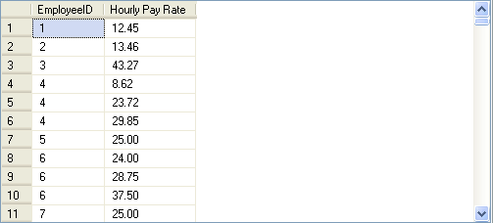
Using Mathematical Functions (Contd.)
The following SQL query retrieves the EmployeeID and Rate for a specified employee id from the EmployeePayHistory table:
SELECT EmployeeID, 'Hourly Pay Rate' = round(Rate,2)
FROM HumanResources.EmployeePayHistory
Output
Notes:
Demonstrate the example given in the slide.

Slide 5
Just a minute
Identify the utility of the datepart() function.
Solution:
The datepart() function is used to extract different parts of a date value.
Notes:
Reiterate the concepts taught earlier by asking the given question.

Slide 6
Just a minute
The management of AdventureWorks wants to increase the shift time from 8 hours to 10 hours. Calculate the end time of the shifts based on their start time.
Solution:
SELECT ShiftID, StartTime, 'EndTime' = dateadd (hh, 10, StartTime) FROM HumanResources.Shift
Notes:
Reiterate the concepts taught earlier by asking the given question.

Slide 7
Using Ranking Functions
What are ranking functions?

Slide 8
Using Ranking Functions (Contd.)
Ranking functions:
Generate sequential numbers for each row or to give a rank based on specific criteria.
Supported by SQL Server are:
row_number()
rank()
dense_ rank()
ntile()
Notes:
8
Student already have learnt about type 2 SCDs in Module I. Therefore, you can start this topic by asking the following questions to students:
What are type 2 SCDs?
Given an example to explain type 2 SCDs.
This will recapitulate what they have learnt about type 2 SCD in Module 1.
Now explain the strategy to update the data into these dimension tables with help the example given in SG.
After explaining the examples, you can ask students to think of an example of a type 2 SCD and then tell the strategy to update the data into this dimension table.

Slide 9
Using Ranking Functions (Contd.)
The row_number() function:
Returns the sequential numbers, starting at 1, for the rows in a result set based on a column.
For example:
SELECT EmployeeID, Rate, row_number() OVER(ORDER BY Rate desc)AS RANK FROM HumanResources.EmployeePayHistory
Notes:
9
Student already have learnt about type 2 SCDs in Module I. Therefore, you can start this topic by asking the following questions to students:
What are type 2 SCDs?
Given an example to explain type 2 SCDs.
This will recapitulate what they have learnt about type 2 SCD in Module 1.
Now explain the strategy to update the data into these dimension tables with help the example given in SG.
After explaining the examples, you can ask students to think of an example of a type 2 SCD and then tell the strategy to update the data into this dimension table.

Slide 10
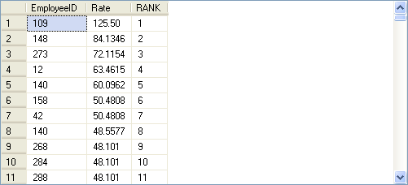
Using Ranking Functions (Contd.)
The following figure displays the output of the preceding query.
Displays the sequential number in a column.
Notes:
10
Student already have learnt about type 2 SCDs in Module I. Therefore, you can start this topic by asking the following questions to students:
What are type 2 SCDs?
Given an example to explain type 2 SCDs.
This will recapitulate what they have learnt about type 2 SCD in Module 1.
Now explain the strategy to update the data into these dimension tables with help the example given in SG.
After explaining the examples, you can ask students to think of an example of a type 2 SCD and then tell the strategy to update the data into this dimension table.

Slide 11
Using Ranking Functions (Contd.)
The rank() function:
Returns the rank of each row in a result set based on specified criteria.
For example:
SELECT EmployeeID, Rate, rank() OVER(ORDER BY Rate desc)AS rank FROM HumanResources.EmployeePayHistory
Notes:
11
Student already have learnt about type 2 SCDs in Module I. Therefore, you can start this topic by asking the following questions to students:
What are type 2 SCDs?
Given an example to explain type 2 SCDs.
This will recapitulate what they have learnt about type 2 SCD in Module 1.
Now explain the strategy to update the data into these dimension tables with help the example given in SG.
After explaining the examples, you can ask students to think of an example of a type 2 SCD and then tell the strategy to update the data into this dimension table.

Slide 12
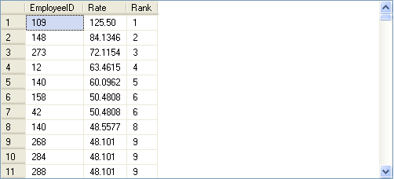
Using Ranking Functions (Contd.)
The following figure displays the output of the preceding query.
The salary rates for the employee IDs 158 and 42 are same.
But the rank for the employee ID 140 is 8, not 7.
Notes:
12
Student already have learnt about type 2 SCDs in Module I. Therefore, you can start this topic by asking the following questions to students:
What are type 2 SCDs?
Given an example to explain type 2 SCDs.
This will recapitulate what they have learnt about type 2 SCD in Module 1.
Now explain the strategy to update the data into these dimension tables with help the example given in SG.
After explaining the examples, you can ask students to think of an example of a type 2 SCD and then tell the strategy to update the data into this dimension table.

Slide 13
Using Ranking Functions (Contd.)
The dense_rank() function:
Is used where consecutive ranking values need to be given based on a specified criteria.
For example:
SELECT EmployeeID, Rate, dense_rank() OVER(ORDER BY Rate desc)AS rank FROM HumanResources.EmployeePayHistory
Notes:
You can summarize the session by running through the summary given in SG.
In addition, you can also ask students summarize what they have learnt in this session.

Slide 14
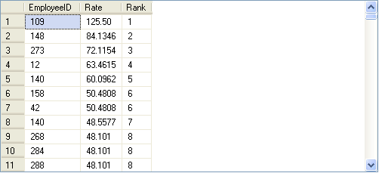
Using Ranking Functions (Contd.)
The following figure displays the output of the preceding query.
The salary rates for the employee IDs 158 and 42 are same.
But the rank for the employee ID 140 is 7, not 8.
Notes:
You can summarize the session by running through the summary given in SG.
In addition, you can also ask students summarize what they have learnt in this session.

Slide 15
Using Ranking Functions (Contd.)
The ntile() function:
Is used to divide the result set into a specific number of groups.
Accepts a positive integer to distribute the rows into the number of groups.
Returns the number of group to which the row belongs for each row retrieved from the database.
For example:
SELECT EmployeeID, BirthDate, HireDate, ntile(4) OVER(ORDER BY BirthDate) AS Rank
FROM HumanResources.Employee
WHERE datepart(mm, HireDate) >= 04 AND datepart(yy, HireDate) >= 2001
Notes:
You can summarize the session by running through the summary given in SG.
In addition, you can also ask students summarize what they have learnt in this session.

Slide 16
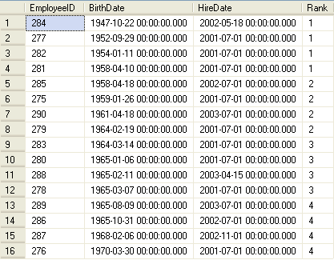
Using Ranking Functions (Contd.)
The following figure displays the output of the preceding query.
Divided into four groups with each group containing four rows and each row in a group is given the same ranking.
Notes:
You can summarize the session by running through the summary given in SG.
In addition, you can also ask students summarize what they have learnt in this session.

Slide 17
Using System Functions
System functions:
Are used to query the system tables.
Are used to access the SQL Server databases or user-related information.
For example:
SELECT host_id() as ‘HostID’
Displays the host ID of the terminal on which you are logged onto.
Notes:
You can summarize the session by running through the summary given in SG.
In addition, you can also ask students summarize what they have learnt in this session.

Slide 18
Using System Functions (Contd.)
The following table lists some of the system functions provided by SQL Server.
Function | Definition | Example
host_name () | Returns the current host computer name of a client process. | SELECT host_name() AS 'HostName'
suser_sid ([‘login_name’]) | Returns the security identification (SID) number corresponding to the log on name of the user. | SELECT suser_sid ('sa') AS SID
user_id ([‘name_in_db’]) | Returns the database identification number corresponding to the user name. | SELECT user_id ('Robert') AS USERID
db_id (['db_name']) | Returns the database identification number of the database. | SELECT db_id('AdventureWorks') AS DatabaseID
db_name ([db_id]) | Returns the database name. | SELECT db_name(17) AS DatabaseName
object_id (‘objname’) | Returns the database object ID number. | SELECT object_id ('AdventureWorks.HumanResources.Employee') AS ObjectID
Notes:
You can summarize the session by running through the summary given in SG.
In addition, you can also ask students summarize what they have learnt in this session.

Slide 19
Summary
In this session, you learned that:
The mathematical functions are used to perform numerical operations.
The ranking functions are used to generate sequential numbers for each row or to give a rank based on specific criteria.
You can use the following functions to rank the records:
row_number()
rank()
dense_ rank()
ntile()
The system functions are used to query system tables.
Notes:
You can summarize the session by running through the summary given in SG.
In addition, you can also ask students summarize what they have learnt in this session.

